Slide 1

Analysis Of Salary Prediction Based on Work Experience Using Random Forest
SUPERVISED - MECHINE LEARNING

Slide 2






TOOLS

Slide 3
OUTLINE
Impor library
Exploratory Data Analysis
Data Preparation
Splitting the data
Random Forest Regression
Evaluasi

Slide 4
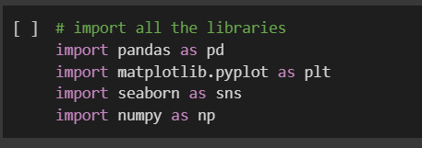
IMPORT LIBRARY

Slide 5
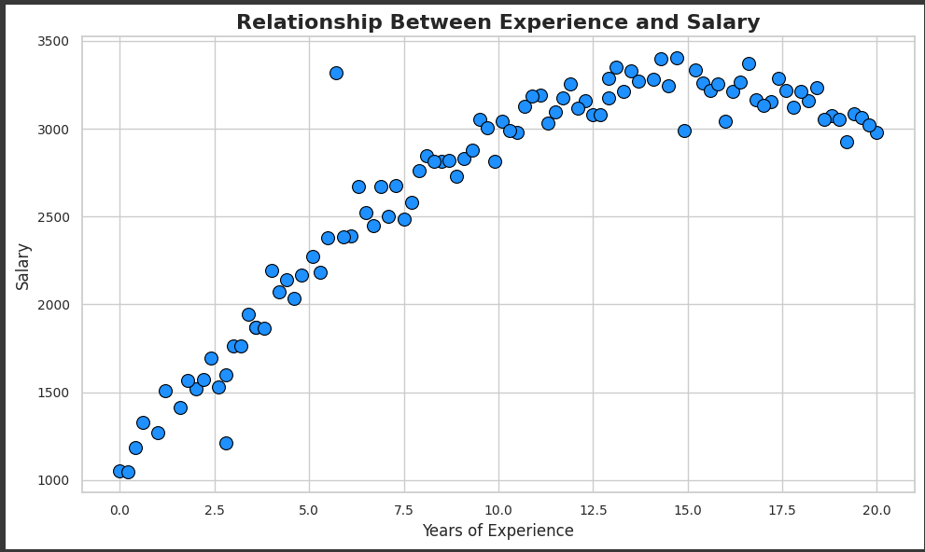
EXPLORATORY DATA ANALYSIS
The higher the work experience, the higher the salary received. This shows a positive correlation between experience and salary.
There are data points that deviate (outliers) from the general pattern, for example one point around 7 years of experience with a salary higher than the general trend.

Slide 6
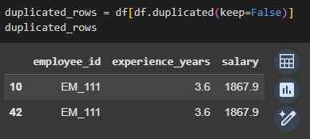
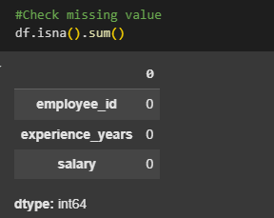
DATA PREPARATION
Data preparation manages duplicate values in data and missing values

Slide 7
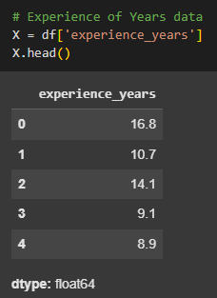
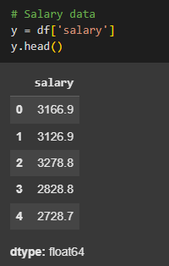
SPLITTING THE DATA
Split data on variabel X
Split data on variabel Y

Slide 8
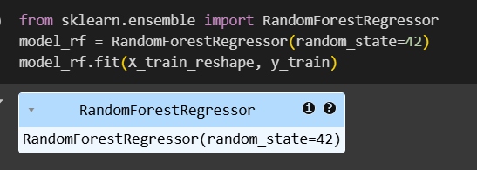
RANDOM FOREST REGRESSION

Slide 9
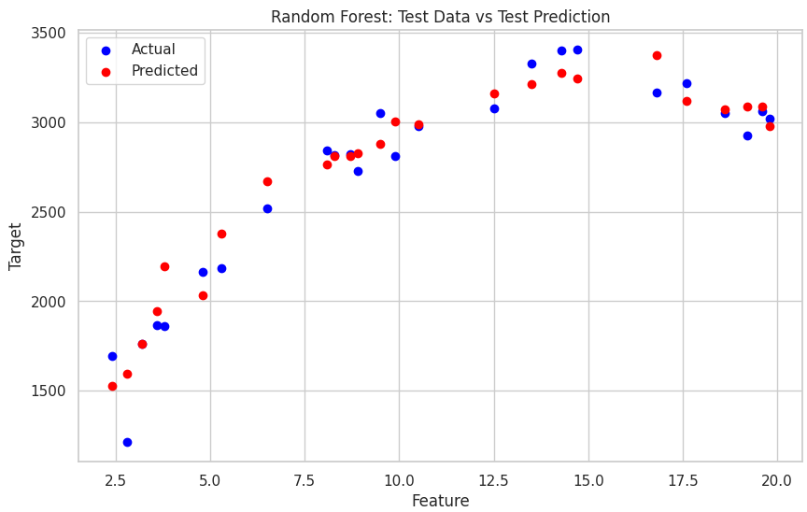
RANDOM FOREST REGRESSION
Red dot (prediction) is quite close to the blue dot (actual), indicating that the model is quite accurate in predicting the target.

Slide 10
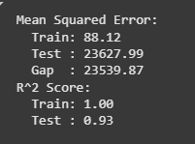
EVALUASI
Evaluation shows the performance value of the Random Forest model is quite good in predicting with an R2 Score of 93%.

Slide 11
SOURCE
Data :
https://drive.google.com/file/d/1F0eScJlePaZkQJxBNCJHhU6p3pE7LHFO/view?usp=sharing

Slide 12
Thank you!
Contact Me for More Information!
Linkedin : Arikanwd

